Slide 1
You are invited to take part in the research study described below. Before you agree to participate, please take time to read the following information carefully and decide whether or not you wish to take part.
What is the purpose of this study?
The purpose of this study is to explore behaviour in a simple computer task. This will help us to understand how humans process stimuli in the world and how this affects attention and learning.
What is the procedure of the experiment?
The experiment will last approximately 20 minutes for which you will be compensated with £2.7. This study uses a task with visual cue stimuli that will be presented on the screen. You will be asked to make a series of responses on each of the trials and performance feedback will be provided after each trial.

Slide 2
Confidentiality
You will be asked to provide some personal information about yourself such as age and gender which will not be identifiable from your data and is only used to understand the demographics of who has taken part in the study. Your responses to all parts of this experiment are anonymous. All collected data will be stored on a password protected computer. The collected data is for research purposes only and may be used to write a research article or present at scientific conferences. For further information about how Lancaster University processes personal data for research purposes and your data rights please visit our webpage: www.lancaster.ac.uk/research/data-protection

Slide 3
Do I have to take part?
Your participation is entirely voluntary. Once you have read this information sheet, you will be asked to give consent in order to continue. You are free to withdraw at any time during the study, by pressing the escape button twice. Once you have left the experiment the data will be reviewed and anonymised and withdrawal will no longer be possible. Whether or not you provide your consent for participation will have no effect on your current or future relationship with Lancaster University and will not incur any penalty. However, if you withdraw your consent, please return the study in prolific.
Who can I contact if I have any questions or concerns?
If you have any questions or concerns regarding this project, please do not hesitate to contact the principal investigator, Dr. Tom Beesley (t.beesley@lancaster.ac.uk) or contact using the Prolific messaging system. If you wish to speak to someone unaffiliated with the study, please contact the Head of the Psychology Department (psychology.hod@lancaster.ac.uk).

Slide 4
The Mutant Creature Lab!
This experiment is designed to examine your learning and memory skills.
In this experiment, you will play the role of a scientist. You have discovered a new set of chemicals that can be used to create mutant creatures! Your task is to learn which chemicals produce which mutants.

Slide 5
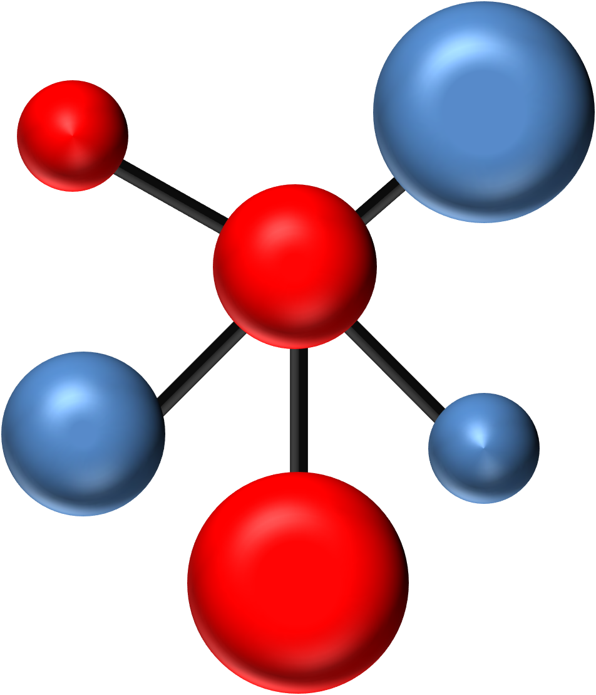

Task 1
In this task you will be presented with various pairs of chemicals at the top of the screen. An example of a "chemical" stimulus is shown below:
On each trial, two chemicals are mixed together, and a mutant creature will be produced (see below for an example of a “mutant” stimulus). Your task is to decide which of two mutants would be produced if the two chemicals presented are combined.
On each trial, select the mutant that you think will be created by clicking on it.

Slide 6
Task 1
Only one of the mutants is the correct outcome in each trial. As soon as you click on it, you will receive feedback on whether you selected the correct mutant. The feedback will consist on a green frame around the correct mutant and the word CORRECT! if you chose the correct mutant or the word INCORRECT! if you chose the wrong mutant.
Use this feedback to learn how to make more accurate responses as the task goes on.

Slide 7
Task 1
On each trial, you will have 10 seconds to choose a mutant. If you exceed this time, you will see a screen saying TIMEOUT - TOO SLOW, and the next trial will then appear. Please try to avoid timeouts as it makes the task longer.
This task takes about 10 minutes. Before clicking the continue button below, please make sure you are in a quiet space and have the time to pay full attention to the task. Make sure there are no distractions to interrupt you when you get started.
The aim of the task is to get as many correct answers as possible, while avoiding timeouts.

Slide 8
Comprehension check
As noted, in this task you will be presented with various pairs of chemicals and two mutants which represent the outcome of combining the chemicals. On each trial, all you need to do is decide which mutant would result from the two chemicals, and then select your choice by clicking on the mutant icon. You need to respond within the 10 seconds trial duration. ​
​
What are you instructed to do in this task?​ (click on the correct answer)
​Please, re-read the instructions above if you are not sure. You will have two opportunities to get this question correct​
​
Learn which mutant would result of each chemicals combination
Predict which mutant would take over the world
Decide if the chemicals are organic or inorganic

Slide 9
Task 2
The following task will require you to take a simple memory test. Two chemicals will appear in the top half of the screen. One of this chemicals has been presented in the task you have just finished, whereas the other is a similar one, but with different colours.
Important: you have seen only one of these chemicals before.
Your task is to select the chemical you have seen before by clicking on it. Once you make your choice, you will be presented with a scale in which you need to rate how certain you are that you made the correct choice, on a scale from 1 (completely uncertain) to 10 (completely certain). If you are guessing, select 1. No feedback will be provided on your choices.

Slide 10
Task 2
This task lasts for about 2 minutes. Before clicking the continue button below, please make sure there are no distractions and that you can pay full attention to the task.
The aim of the task is to try your best and be honest about the confidence of your choices.

Slide 11
Comprehension check
Two chemicals will appear in the top half of the screen. One of these chemicals has been presented in the task you have just finished, whereas the other is a similar one, but with different colours. Your task is to select the chemical you have seen before by clicking on it. Once you make your choice, you will be presented with a scale to rate how certain you are that you made the correct choice (from 1 = completely uncertain to 10 = completely certain). ​
​
What are you instructed to do in this task?​ (click on the correct answer)
​Please, re-read the instructions above if you are not sure. You will have two opportunities to get this question correct​
​
Click on the mutant that would result of each chemicals combination
Select the chemical you have seen before
Rate how beautiful the chemicals presented are

Slide 12
Task 3
This task is very similar to the previous memory test. On each trial, two chemicals will be presented and you have only seen one of them before in the learning part of the experiment (Task 1). However, this time the two chemicals will not be similar. Your task is the same, choose the one you have seen in the first part of the experiment (Task 1).
As before, your task is to select the chemical you have seen before by clicking on it. Once you make your choice, you will be presented with a scale in which you need to rate how certain you are that you made the correct choice, on a scale from 1 (completely uncertain) to 10 (completely certain). If you are guessing, select 1. No feedback will be provided on your choices.

Slide 13
Task 3
This task lasts for about 4 minutes. Before clicking the continue button below, please make sure there are no distractions and that you can pay full attention to the task.
The aim of the task is to try your best and be honest about the confidence of your choices.

Slide 14
Comprehension check
On each trial, two chemicals will be presented. As before, only one of these chemicals was presented in the learning part of the experiment (Task 1). However, this time the two chemicals will not be similar. Your task is to choose the one you have seen in the first part of the experiment (Task 1) by clicking on it. Once you make your choice, you will be presented with a scale to rate how certain you are that you made the correct choice (from 1 = completely uncertain to 10 = completely certain). ​
​
What are you instructed to do in this task?​ (click on the correct answer)
​Please, re-read the instructions above if you are not sure. You will have two opportunities to get this question correct​
Click on the mutant that would result of each chemicals combination
Select the chemical you have seen in Task 1
Rate how beautiful the chemicals presented are

Slide 15
Thank you for your participation in this study.
This study is part of a series of experiments that are designed to investigate attentional processes underlying human learning. Specifically, we aim to explore how the stimuli are processed under different levels of attention.
Once a cue is associated with a meaningful outcome (i.e., a response and/or a reward) an attentional bias towards this cue is established. The learnt predictive value of the cue leads to more overt attention being allocated towards it, which increases how much we learn about that cue in the future.
This experiment examines whether higher attention also leads to better recollection of the stimuli.

Slide 16
Findings from this experiment will contribute to our understanding of processes underlying the interaction between attention and learning, which can also enhance our understanding of maladaptive mechanisms. For example, if attention is found to be automatically directed to previously predictive cues then this would indicate that conscious efforts to change behaviour are ineffective on their own. As such, cognitive retraining may be necessary to reverse maladaptive attentional biases that automatically associate harmful stimuli (e.g. drugs) with reward.
If you do not wish for your data to be included in this study, please inform the principle investigator, Dr. Tom Beesley (t.beesley@lancaster.ac.uk), or contact using the Prolific messaging system before leaving the experiment. Once the data have been reviewed, they would be fully anonymized and will no longer be identifiable as belonging to you.

Slide 17
If you wish to read more about research surrounding this study, please read:
Le Pelley, M. E., Beesley, T., & Griffiths, O. (2011). Overt attention and predictiveness in human contingency learning. Journal of Experimental Psychology: Animal Behavior Processes, 37(2), 220.
If you have any questions regarding the study, please feel free to contact a member of the research team. If you would like to discuss your concerns with someone unaffiliated with the study, you may also contact the Head of Department, Prof. Kate Cain (psychology.hod@lancaster.ac.uk).

